Slide 1
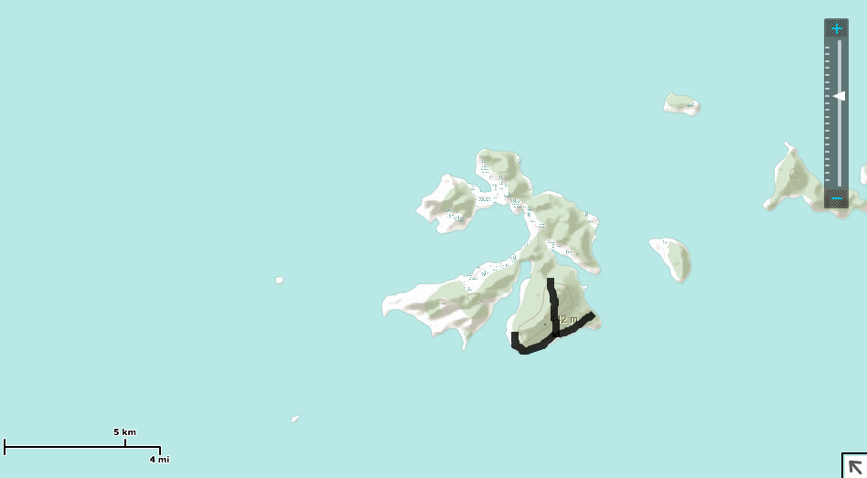

Cave
Mountain
Jungle
Escape
Palm Tree
Shack
Ocean

